Slide 1
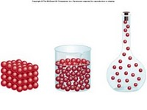
Density Lesson 1
Calculated Volume and Mass

Slide 2
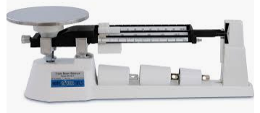
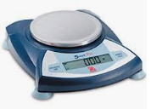
Mass
• Measurement of the amount of __________ (or stuff) in an object
• Measured in ______________
matter
grams (g)

Slide 3
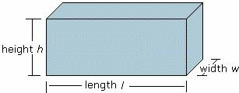
Volume
• Measurement of the amount of
________ an object takes up
• Measured in milliliters _________
space
(ml) or cm³

Slide 4
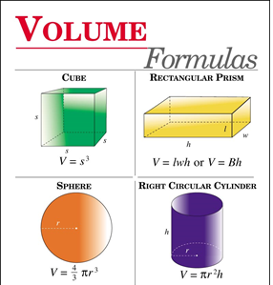
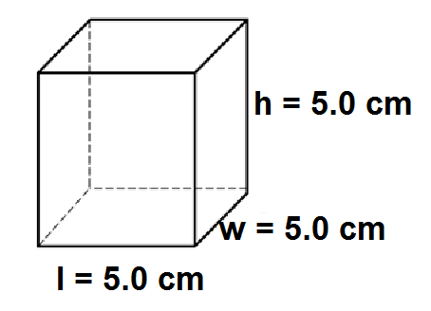
Finding volume:
Method 1: Calculate using
Formulas:
Volume = l x w x h = 5.0 x 5.0 x 5.0 = 125 cm3
Place in water and measure the displaced water (more about this method in Density Lesson 2!!)
Method 2: Place the object in water and measure the displaced water (more about this method in Density Lesson 2!!)

Slide 5
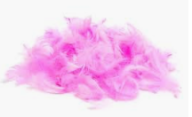
Which has the greater mass? The greater volume? Which has the greater density?
1 kg of feathers
1 kg of rocks
Same Mass!
Feathers have greater volume.
Rock has greater density.

Slide 6
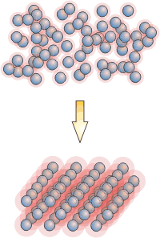
How are mass and volume related?
Density

Slide 7
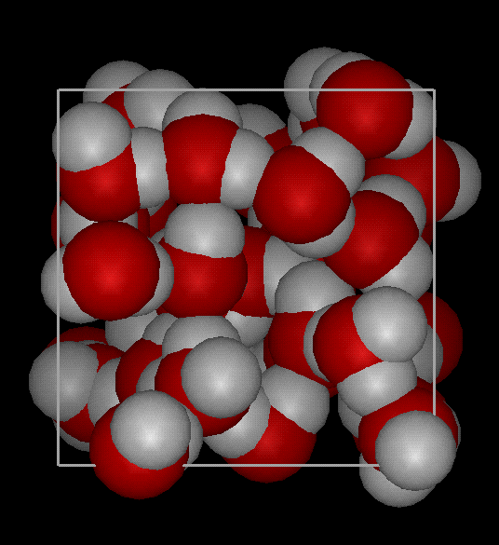
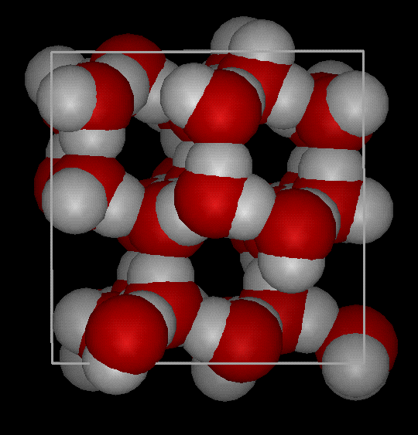
Density
matter within
Density is the amount of _________________
_________________________
It is a measure of ____________________the atoms are in an object.
a volume.
how tightly packed
Notes:
Density is the amount of matter within a certain volume.

Slide 8
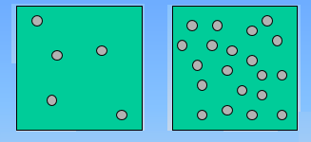
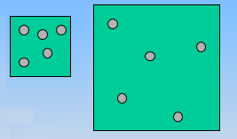
Which one is more dense?
Because there
is
less space!

Slide 9
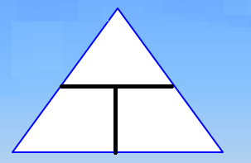
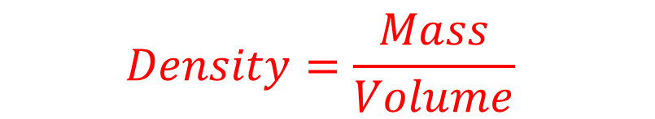
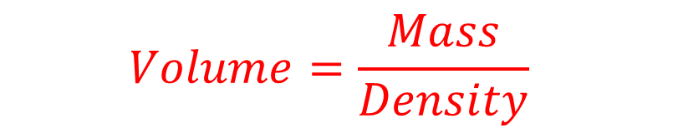

Calculating density
Formula:
M = mass
V= volume
D = density
$$Density=\frac{Mass}{Volume}$$
M
D
V
Rearranging:
$$Mass=Density ∗Volume$$
$$Volume=\frac{Mass}{Density}$$

Slide 10
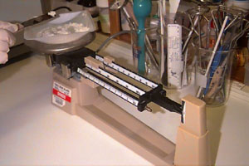
To find the density of an object
mass
1- Find the __________
volume
2- Find the __________
Divide
3- ___________
Density = Mass
Volume
ALWAYS REMEMBER _______!
units

Slide 11
Problem:
The mass of a box is 21.0 g and it takes up 7.0 cm³ of space. Find the density.
Use the _________ method.
G→ Given
U→ Unknown (?)
E→ Equation
S→ Solve
S→ Sentence
GUESS

Slide 12
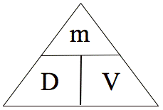
Ex: The mass of a box is 21.0 g and it takes up 7.0 cm³ of space. find the density.
G:
U:
E:
S:
S:
m = 21.0 g V= 7.0 cm³
D = ?
D = m
V
D = 21.0 g
7.0 cm³
= 3.0 g/cm³
∴ the density is 3.0 g/cm³.

Slide 13
Example 2
Ms. R. has a green pen. The pen has a volume of 2.0 cm³ and a density of 1.2 g/cm³. What is the mass of the pen?
G:
U:
E:
S:
S:
V= 2.0 cm³ D=1.2 g/cm³
M= ?
M= D x V
M= 1.2 g/cm3 x 2.0 cm³ =
2.4 g
∴ The pen mass is 2.4 g.

Slide 14
Let’s try! Work on these problems with your neighbor! Use your GUESS labels and equation triangle!
1 Jamil has a paper clip. It has a mass of 9.0 g and a volume of 3.0 cm³. What is its density?
2. Sanpreet has an eraser. It has a mass of 8.0 g, and a density of 1.5 g/cm³. What is its Volume?
3. Kiranjot has a rock. The rock has a volume of 12.9 cm³and a density of 1.8 g/cm³. What is the mass of the rock?

